Slide 1

NAUGHTS AND CROSSES
ARTIFICIAL INTELLIGENCE (AI101B)
EVEN SEMESTER
Project Supervisor:
KOMAL SALGOTRA
Asst. Professor
YATHARTH TYAGI 202410116100254
VISHAL SINGH 202410116100251
VINAYAK CHAUHAN 202410116100245
VIBHOR TYAGI 202410116100240

Slide 2
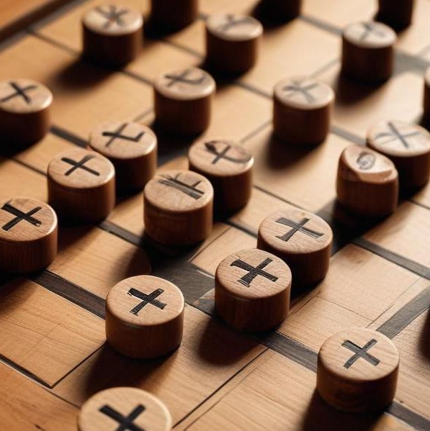
Noughts and Crosses
Exploring the game with Alpha-Beta Pruning in Python

Slide 3

Introduction
This presentation delves into the game of Noughts and Crosses, also known as Tic-Tac-Toe. It focuses on the implementation of the game using Alpha-Beta Pruning, a fundamental AI technique to enhance the efficiency of decision-making in game play.

Slide 4

01
Game Overview
Noughts and Crosses (Tic-Tac-Toe) is a classic 3x3 grid game.
The goal is to align three marks (X or O) in a row, column, or diagonal.
AI uses Minimax Algorithm with Alpha-Beta Pruning for smart moves.
Players take turns, and AI plays optimally to win or draw.
The game ends when a player wins or the board is full.

Slide 5
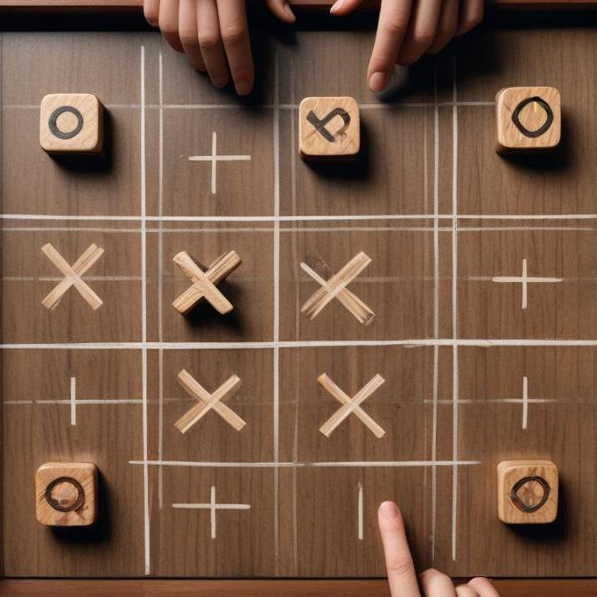
Rules of Noughts and Crosses
Noughts and Crosses is a two-player game played on a 3x3 grid. Players take turns placing their symbol (either 'X' or 'O') in an empty cell. The first player to align three of their symbols horizontally, vertically, or diagonally wins. If all cells are filled without a winner, the game results in a draw.

Slide 6
Objectives of the Game
The main objective in Noughts and Crosses is to strategically place your symbols while simultaneously preventing your opponent from winning. Players must think ahead to foresee potential moves and counter their opponent's strategy, making it a game of skill, foresight, and strategy.

Slide 7
Basic Concepts of AI in Gaming
Artificial Intelligence (AI) in gaming refers to the simulation of human-like decision making by computer programs. In games like Noughts and Crosses, AI is used to create a challenging opponent. The main concepts include game tree exploration, evaluating possible moves, and selecting optimal strategies to win or achieve a draw. AI can analyze potential outcomes based on player moves, enhancing the gameplay experience.

Slide 8

02
Alpha-Beta Pruning

Slide 9
Concept of Alpha-Beta Pruning
Alpha-Beta Pruning is an optimization technique for the minimax algorithm used in decision-making processes. It significantly reduces the number of nodes evaluated in the search tree. The method keeps track of two values: alpha (the best score possible from the maximizer's perspective) and beta (the best score for the minimizer), allowing the algorithm to eliminate branches that won't affect the final decision. This leads to faster calculations and more efficient gameplay.

Slide 10
Benefits in Game Playing
The primary benefit of Alpha-Beta Pruning is its efficiency. By eliminating unnecessary branches in the game tree, it allows the AI to explore deeper levels of strategy in less time. This results in a stronger opponent for players and a more engaging gaming experience. Additionally, it reduces computational resources, making it ideal for games with larger state spaces.

Slide 11

Implementation in Python
Implementing Alpha-Beta Pruning in Python typically involves modifying the minimax algorithm. The algorithm recursively evaluates the game tree, applying the pruning technique by comparing alpha and beta values at each node. A simple implementation includes defining a minimax function with two additional parameters for alpha and beta, checking these values before exploring further moves.

Slide 12

Conclusions
In summary, Noughts and Crosses can be enhanced through AI techniques like Alpha-Beta Pruning. These techniques not only improve the capabilities of game-playing AI, making them more competitive yet manageable, but also provide an insightful understanding of strategic thinking in games. The efficient implementation of these concepts in Python allows for both learning and practical application.

